Slide 1
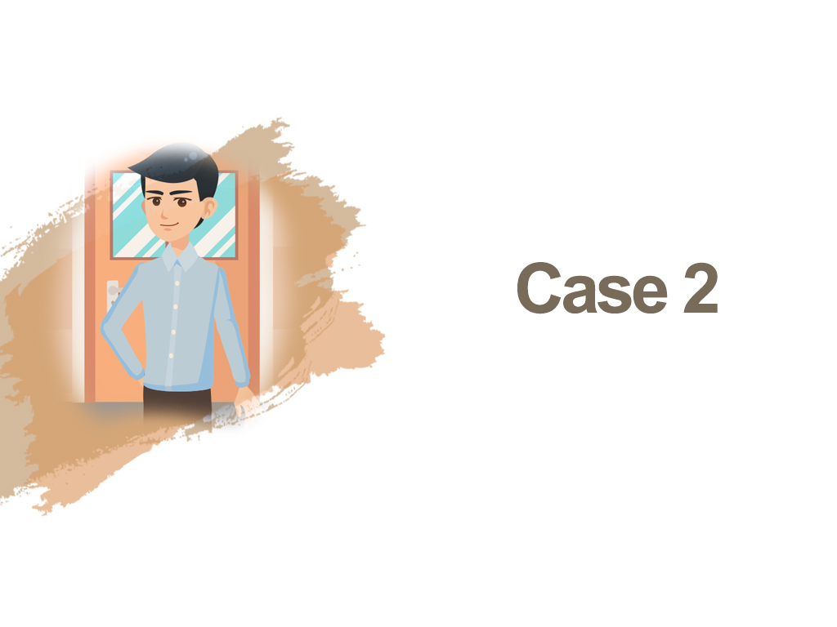

Slide 2

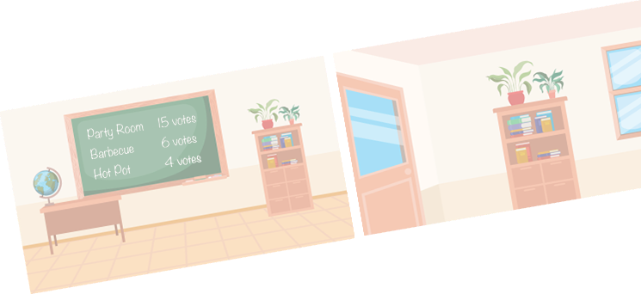
In schools, teachers usually foster
teacher-student relationships and
student-peer relationships through
class management strategies such
as formulating class rules, forming class committees and organising activities…

Slide 3











A memorable experience of conducting or organising a class activity and what you have learnt from it.

Slide 4

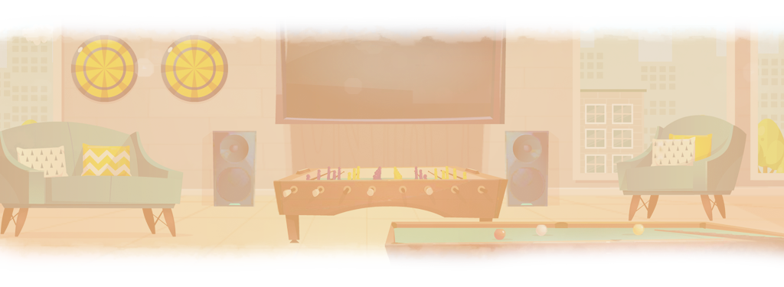



Slide 5


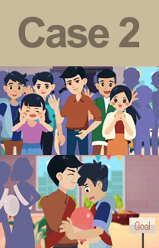

Do you agree that Mr Cheung should
arrange this class activity? Why?
What are your thoughts on the teacher-
student interactions and student-peer
interactions in this particular case?

Slide 6


How to foster teacher-student
relationships through school
activities?
According to school guidelines,
teachers should pay attention
to the following when leading
activities…

Slide 7


Be committed to the profession
as a strict but caring teacher
Exercise propriety as well as build a positive teacher-student
relationship based on rapport and mutual trust
Uphold professional conduct and foster good character and
attitudes in students
Avoid inappropriate physical contact with students
Endeavour to safeguard teachers’ professionalism and ensure
the well-being of students

